Slide 1



Alkaline Lakes as Planetary Analogs
for Extraterrestrial Aqueous Environments
Karla Paredes Aguilar
Mentor: Dr. Dante Lauretta
University of Arizona
Space Grant Symposium 2025
Scottsdale, Arizona
April 19th, 2025

Slide 2
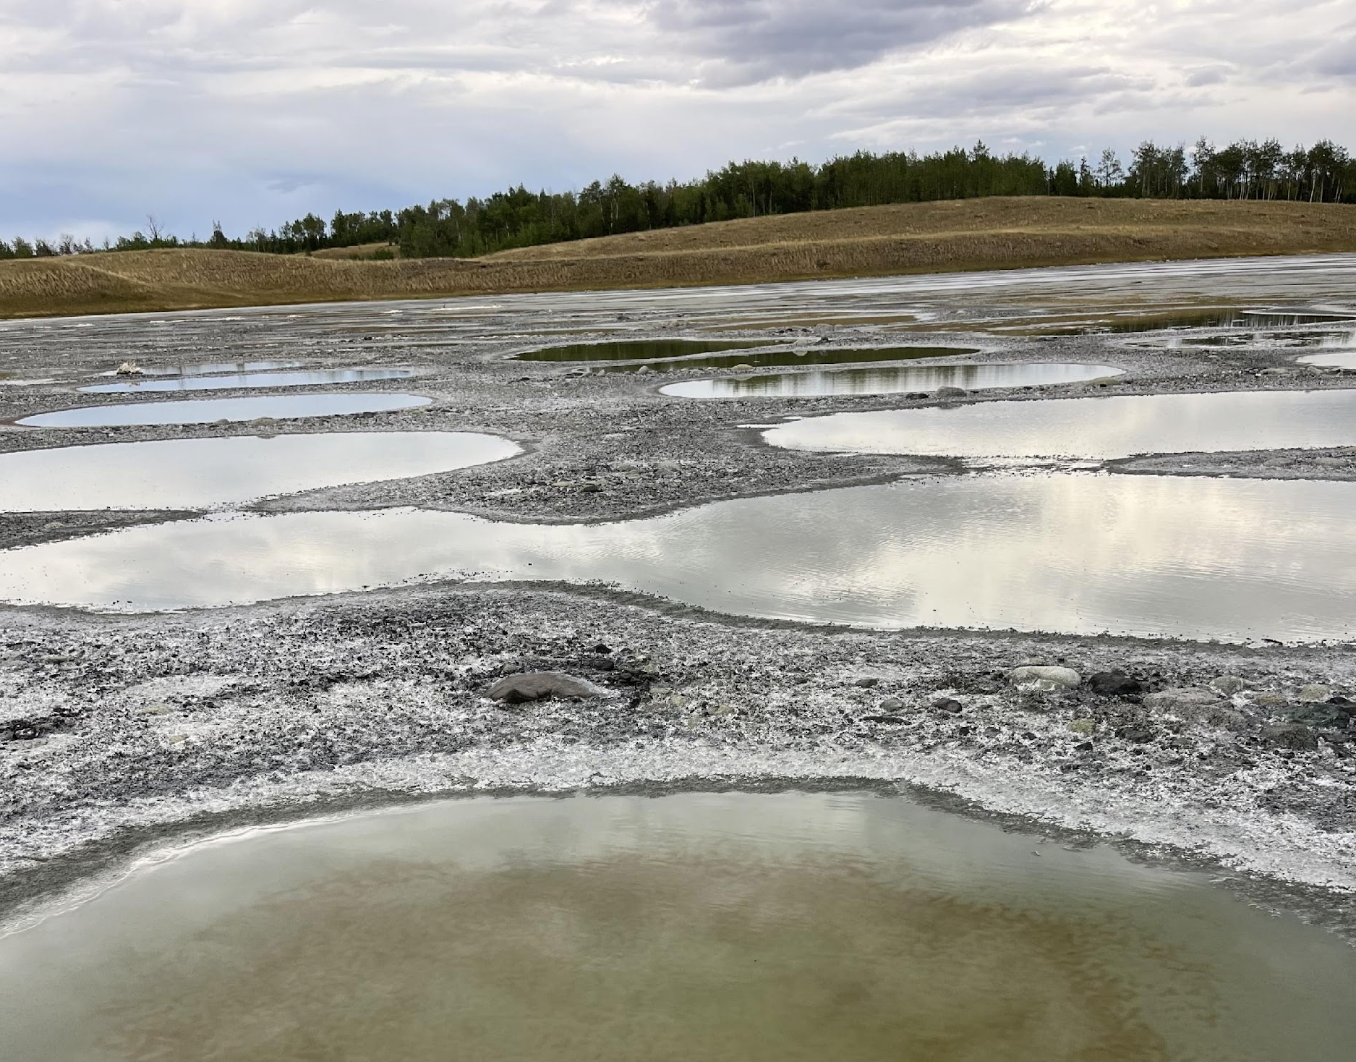

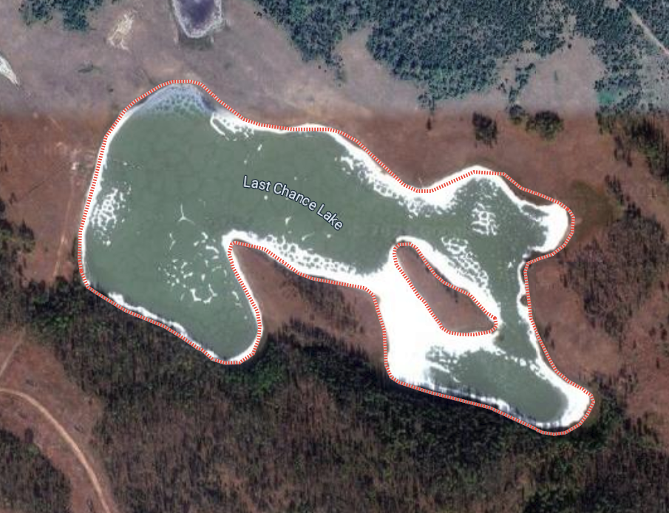
Motivation
Phosphorus is essential for life (DNA, RNA, ATP and lipids)
“Phosphorus Problem”
Alkaline lakes
Saline, high pH and high concentration of carbonate salts
Last Chance Lake
British Columbia, CA
Highest concentration of natural phosphate on Earth
Investigate mineralogical and geochemical processes in Last Chance Lake and compare findings with extraterrestrial samples and confirm the location of the phosphorus
Source: earthsky.org
Source: Maia Palka
Source: Google Maps
Notes:
Phosphorus Problem is a scientific dilemma that chemical reactions that make the building blocks of life need a lot of phosphorus, but phosphorus is scarce. carbonate-rich lakes have up to 50,000 times phosphorus levels found in seawater, rivers and other types of lakes. Such high concentrations point to the existence of some common, natural mechanism that accumulates phosphorus in these lakes.“The extremely high phosphate levels in these lakes and ponds would have driven reactions that put phosphorus into the molecular building blocks of RNA, proteins, and fats, all of which were needed to get life going,”

Slide 3
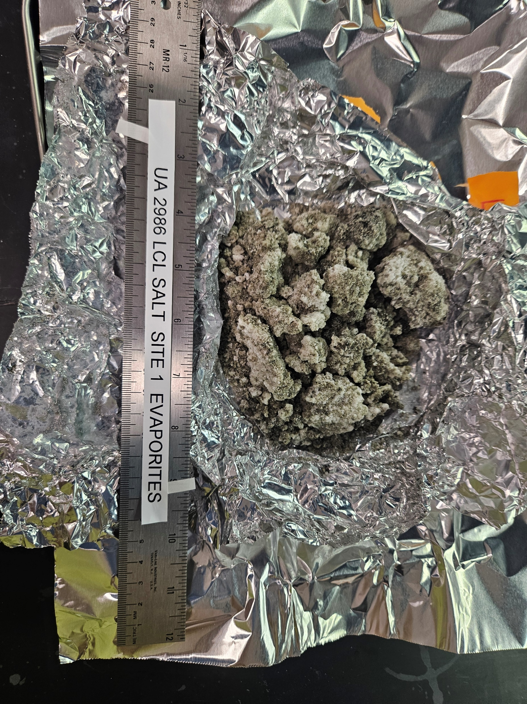
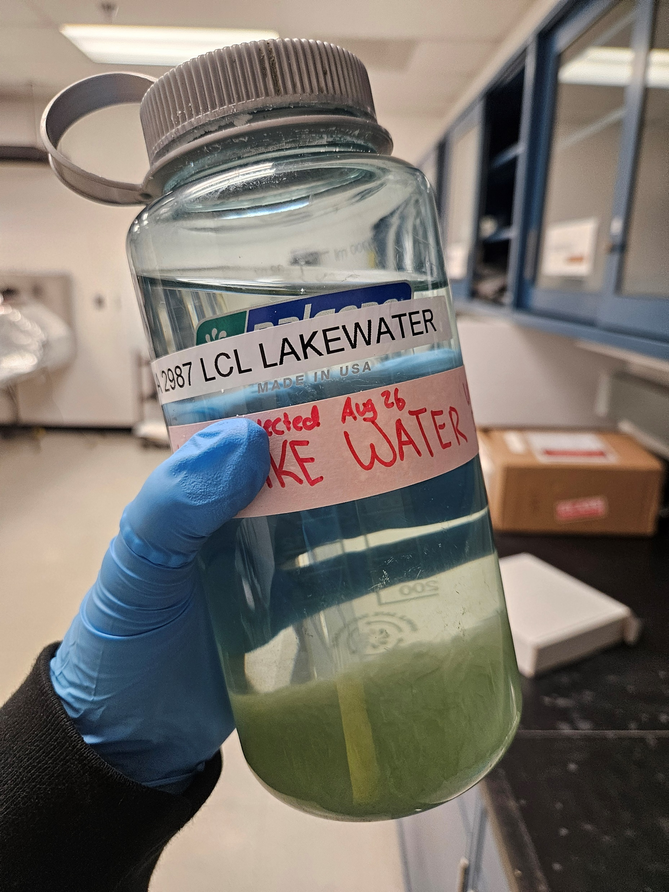
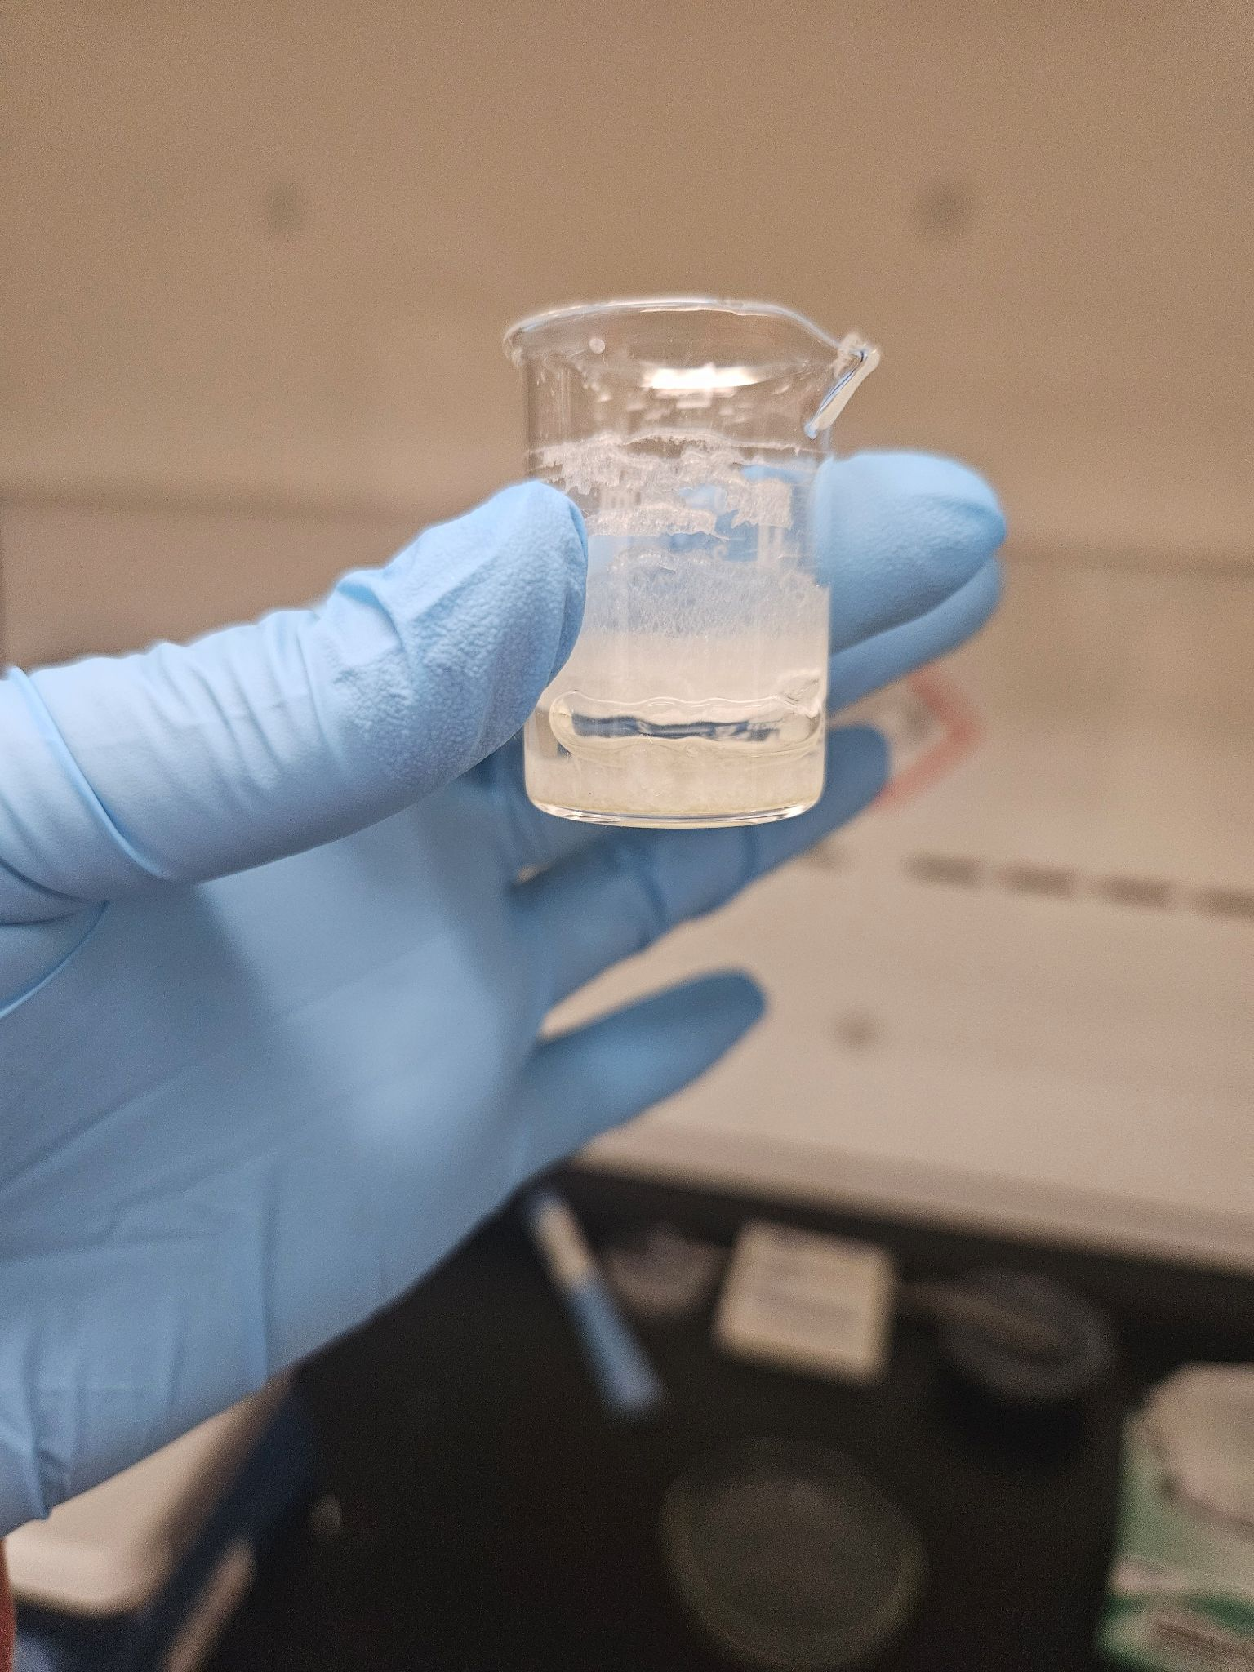
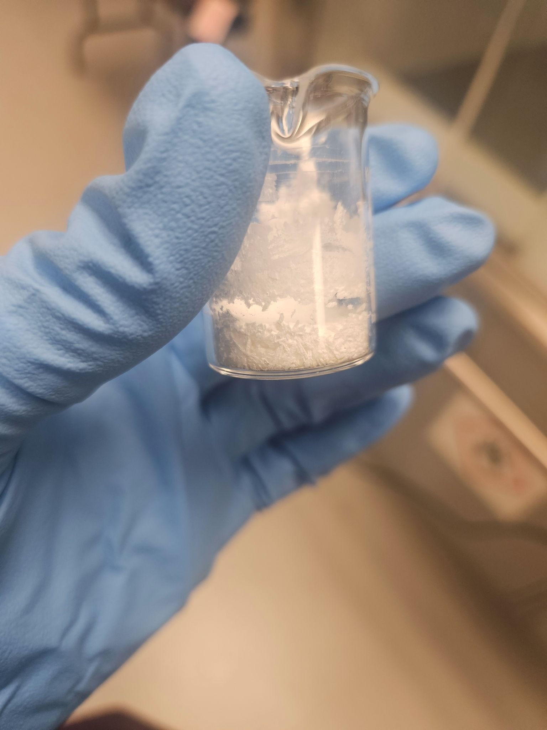
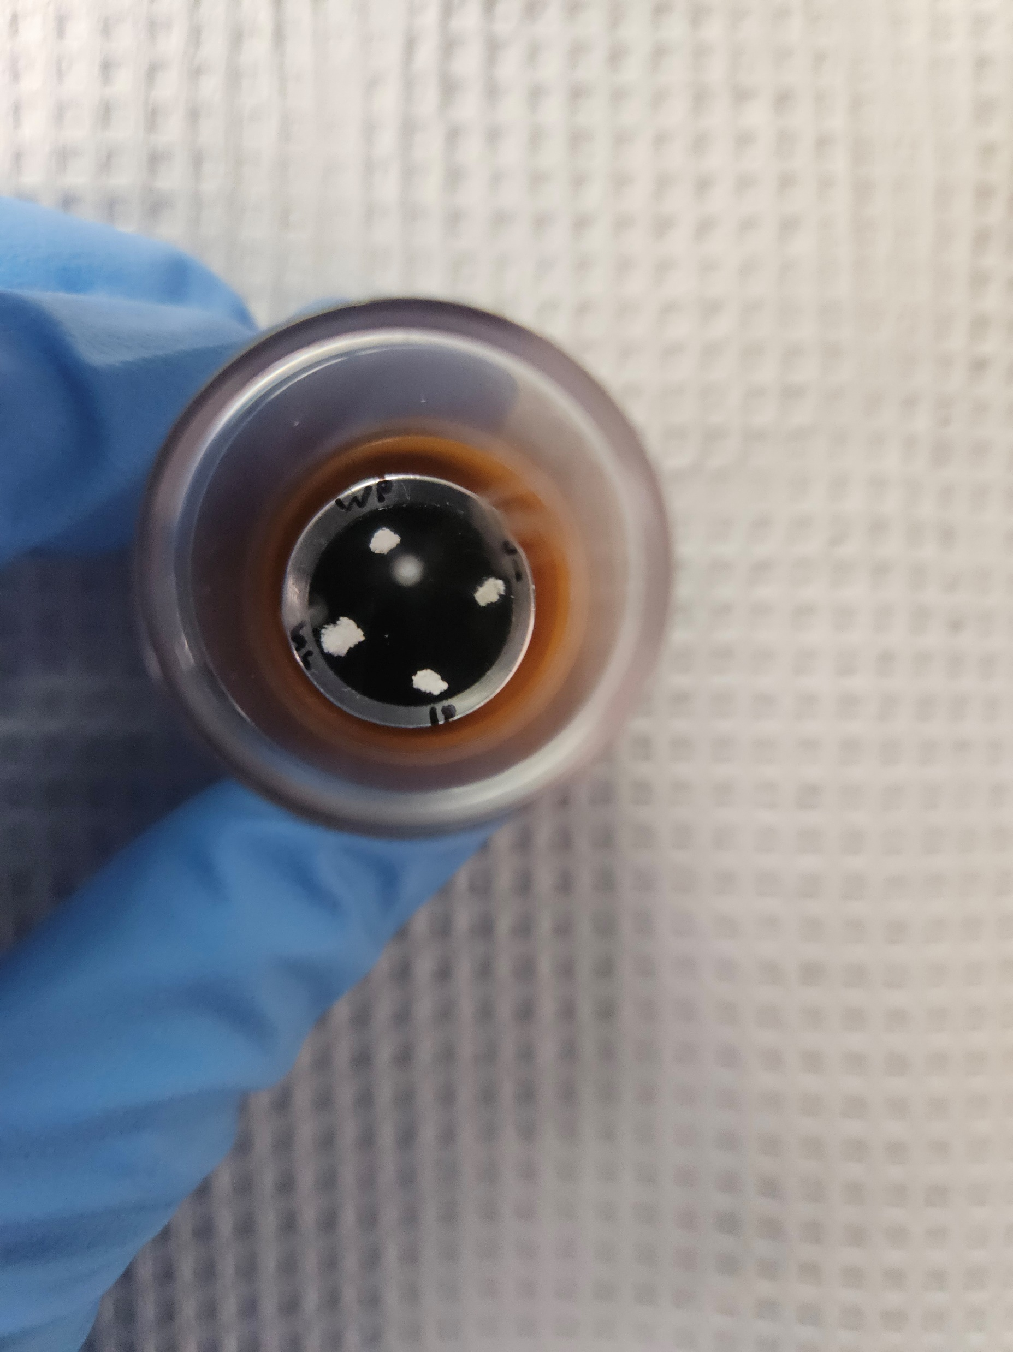
Methods
Sample Collection:
Brine water (1L) and evaporites (~167g) collected in August 2024 by Maia Palka (UBC)
Experimental Setup:
A 10 mL sample of lake brine was pipetted into a 10 mL beaker and left to evaporate under a fume hood at room temperature for three weeks until fully dried. Once desiccation was complete, evaporite particles with different textures were manually selected for further analysis.
Notes:
We did do analysis on the evaporite samples, but quickly I found the phosphate was not there, so thenI turned to the water, and make my own evaporite samples

Slide 4
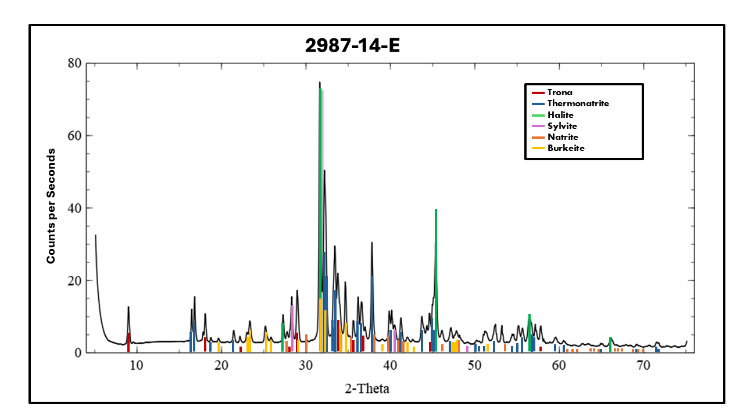
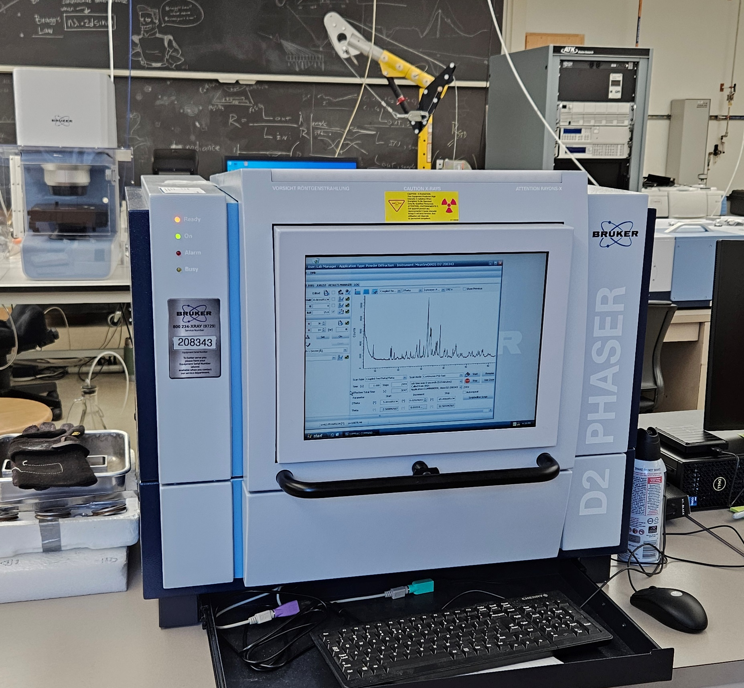
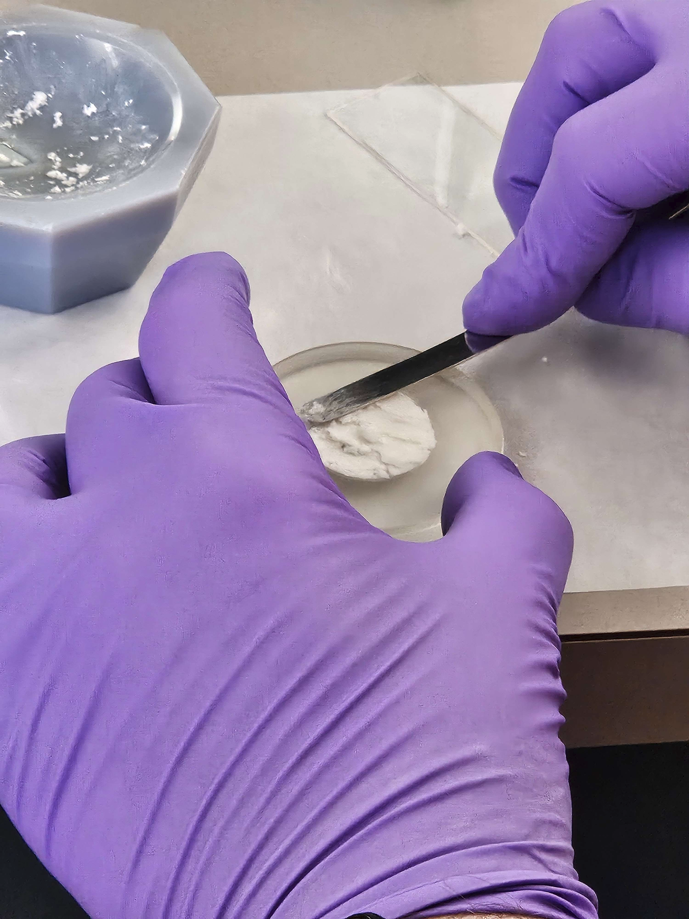
Analysis : X Ray Diffraction
XRD Peaks - 2987-14-E
Mineral | Formula
Trona | Na₃H(CO₃)₂·2H₂O
Thermonatrite | Na₂CO₃·H₂O
Halite | NaCl
Sylvite | KCl
Natrite | Na₂CO₃
Burkeite | Na₆(CO₃)(SO₄)₂
XRD: Identify the crystalline structure of materials.
Sample Preparation:
Powder sample
Analysis:
Match peaks using a database
Results:
Carbonate salts!
Notes:
You shine X-rays on it, and the way those X-rays bounce off the tiny crystals inside gives you a unique pattern — kind of like a fingerprint.

Slide 5
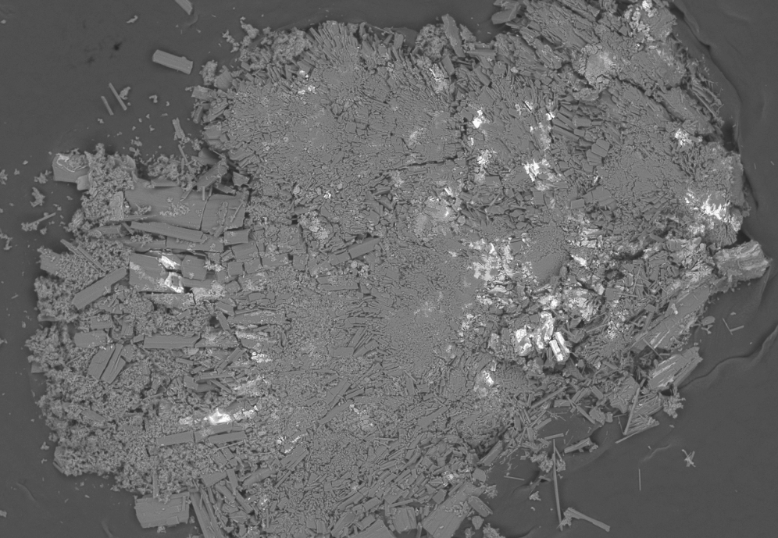
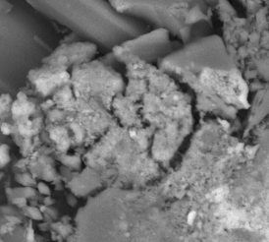
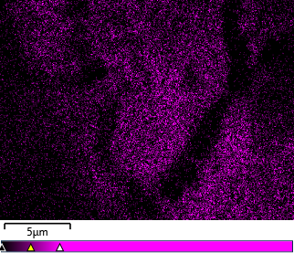
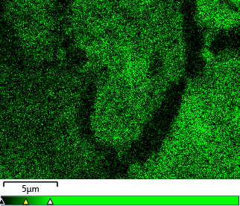
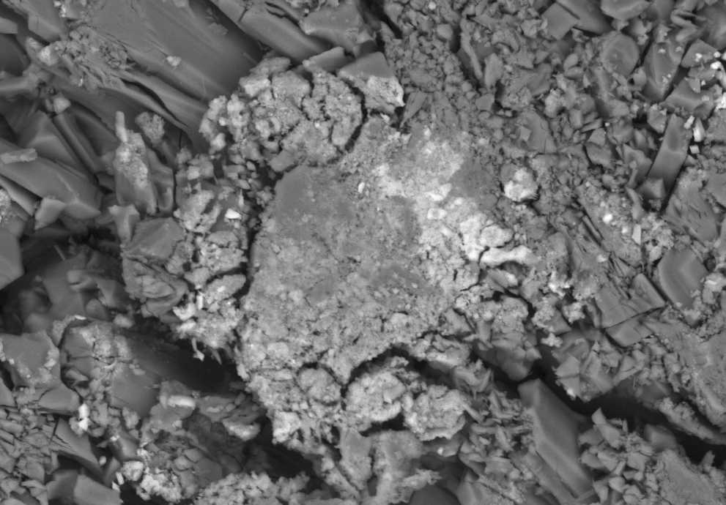
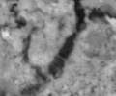
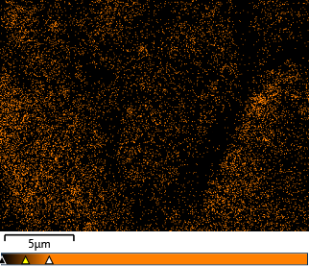
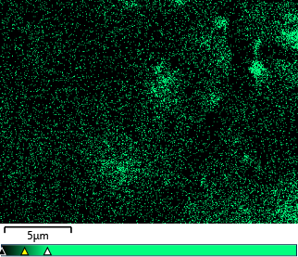
Analysis: SEM & EDS
Scanning Electron Microscopy (SEM): Capture detailed images of the crystal shapes and structures
Electron Dispersive Spectroscopy (EDS) : Identify the specific elements in the minerals and chemical maps
SEM
EDS
A
C
B
D
Phosphorus
Sodium
Scale of images: A- 500 µm, B- 50 µm, C- 30 µm D - 5 µm
Magnesium
Chloride
Notes:
looking for P
. Atomic Number Contrast (Material Composition)

Slide 6
Analysis : Ion Chromatography
Ion Chromatography : used to separate, identify, and measure ions (cations and anions)
Results:
Seasonal variability of brine chemistry
Evaporation-driven increases in summer and potential dilution or mineral precipitation in fall.
Implication:
One sample shows an incomplete picture
Chemical Composition of LCL UA Sample vs Haas et al., 2024
Anion | 6/22 | 8/24 | 9/22 | 11/22
Cl⁻ | 100 | 83.2 | 970 | 285
PO₄³⁻ | 3.06 | 2.94 | 16 | 6.2
SO₄²⁻ | 43 | 121.44 | 100 | 59
Cation
Na | 1,500 | 2,655.5 | 3,400 | 1,700
Mg | 0.88 | 0.531 | 1.2 | 1.5
Ca | 0.061 | 0.378 | 0.45 | 0.080
Table 1. Anion and cation concentrations (mM)
Notes:
analytical technique used to separate, identify, and measure charged particles (called ions) in a liquid sample.
Done by ALEC Lab at the UA
risks oversimplifying the lake’s chemistry

Slide 7
Interpretation & Conclusion
XRD Peaks - 2987-14-E
Mineral | Formula
Trona | Na₃H(CO₃)₂·2H₂O
Thermonatrite | Na₂CO₃·H₂O
Halite | NaCl
Sylvite | KCl
Natrite | Na₂CO₃
Burkeite | Na₆(CO₃)(SO₄)₂
XRD: Asteroid Bennu (101955) & Asteroid Ryugu (162173)
Ion Chromatography: Seasonal variability of brine chemistry & Regular sampling ensures a more accurate understanding of seasonal processes
SEM-EDS: confirms phosphorus concentration within the evaporitic material.
Mars’ data show carbonate minerals, clays, and salt deposits in ancient lake beds.
Dawn mission detected sodium carbonate on surface of Ceres
Galileo spacecraft and recent telescope observations suggest a subsurface ocean rich in salts, likely containing sodium carbonate and magnesium sulfate.
Last Chance Lake provides insights into aqueous processes, mineral formation, and geochemical cycling in extreme environments. Alkaline lakes are valuable analogs for interpreting mineralogical and chemical signatures, aiding in the search for past or present life and guiding future astrobiological missions.

Slide 8
Acknowledgements
Dr. Dante Lauretta
Dr.Jessica Barnes
Dr.Ralph Milliken
Dr.Kevin Robertson
Dolores Hill
Nathalia Vega Santiago
Arizona Astrobiology Center
Arizona Space Grant Consortium

Slide 9
Thank you!

